Slide 1
Google Mybusiness - Car Wash
It is a choice to be dominate Google Mybusiness in your local area

Slide 2
I am not an expert - Just pragmatic!
Pragmatic - how can I sell more cars?
You want to know more about me, and all my articles? Connect with me on Linkedin! “pauldevries1972”

Slide 3
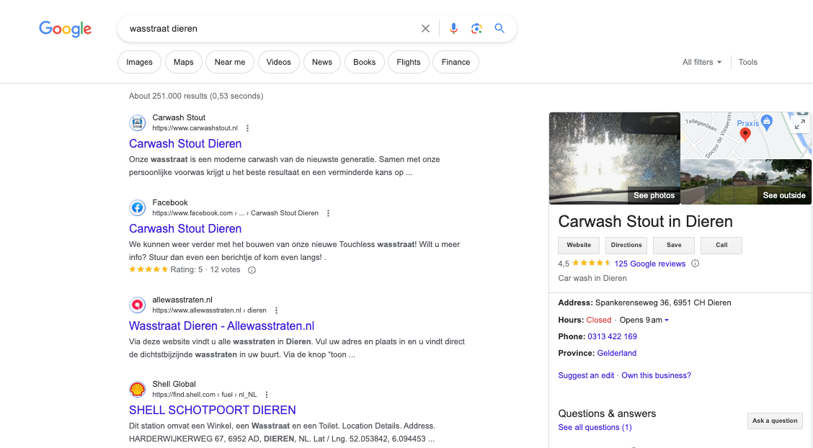

Slide 4
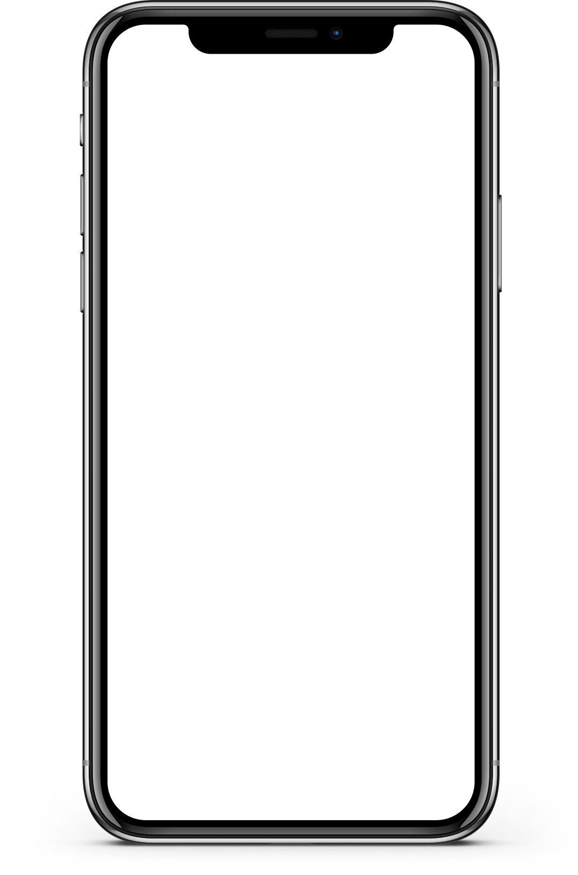
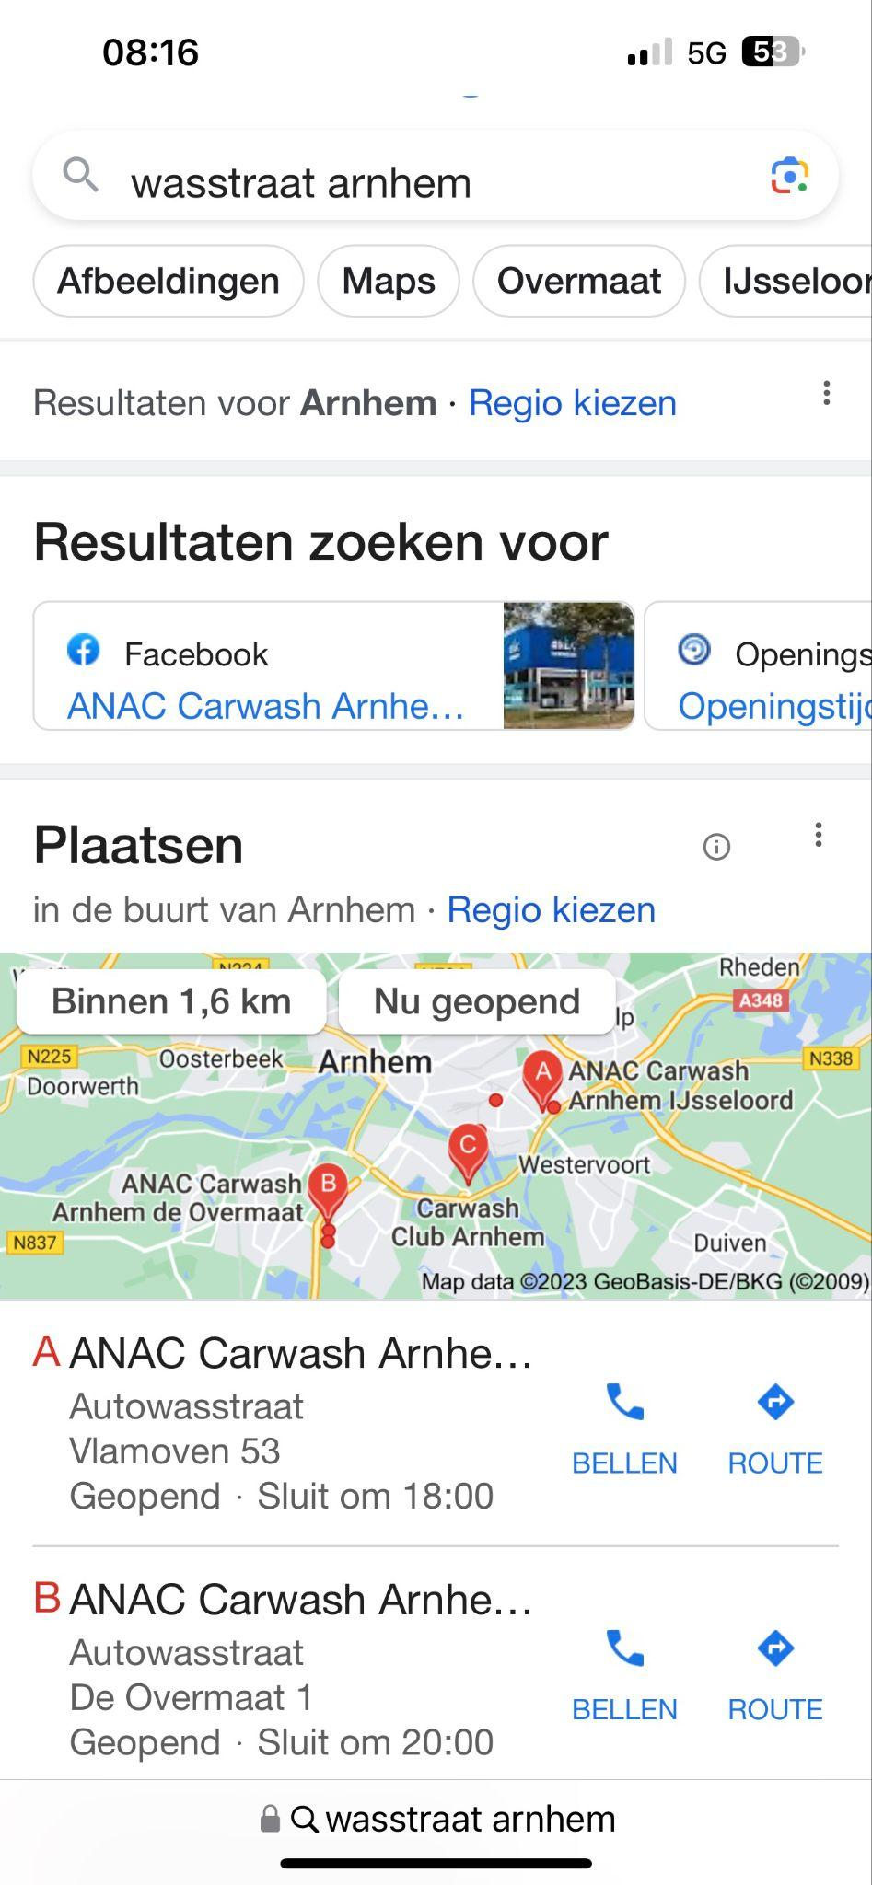
Especially on mobile devices is GMB the driver of the best quality traffic to your website, directions or phone number!

Slide 5
How to dominate your local area for car wash?

Slide 6
GMB is: Digital Hygiëne
And yes it is more work, and just another digital showroom to keep updated!

Slide 7
GMB is: Local SEO
An optimize GMB will only work locally, and is actually designed for……restaurants!

Slide 8
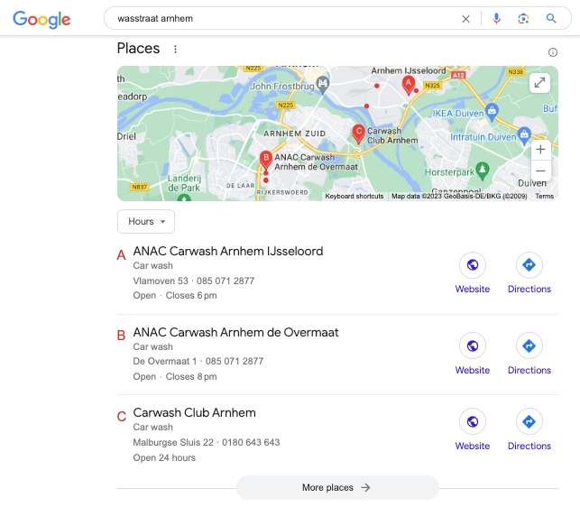
The Google local pack
Not yours entirely
Big markets, widen searches
Especially for more then carwash
Winners are usually changes or passion entrepreneurs

Slide 9
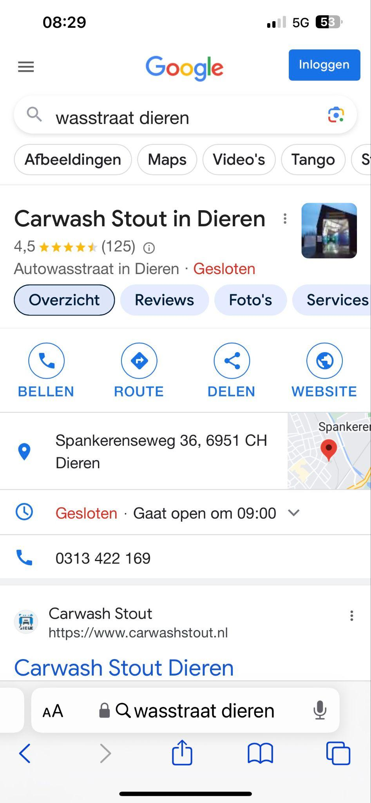
Result Zero
Will take the whole mobile screen
Narrow searches
Online real estate to the max!

Slide 10
How to win?
Proximity - Is the business close(enough) to the searcher?
For example “car wash near me” in Amsterdam is different then in Antwerpen

Slide 11
How to win?
Prominence - High Google Review Ratings
More wins! You cannot have enough Google Reviews in your GMB!

Slide 12
How to win?
Relevance - Do you sell what the searcher is looking for?
The more information you give GMB the better the results! Especially by extra services

Slide 13
How to win?
You cannot win on your location, so Prominence and Relevance is up to YOU!

Slide 14
Prominence
It is not only about 5 star reviews!
What they write is just that important!

Slide 15
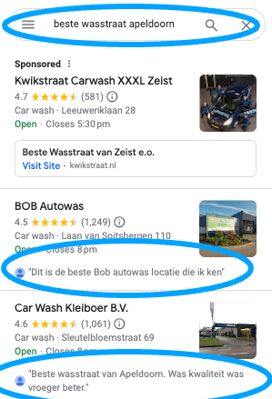
Prominence
It is not only about 5 star reviews!
What they write is just that important!

Slide 16
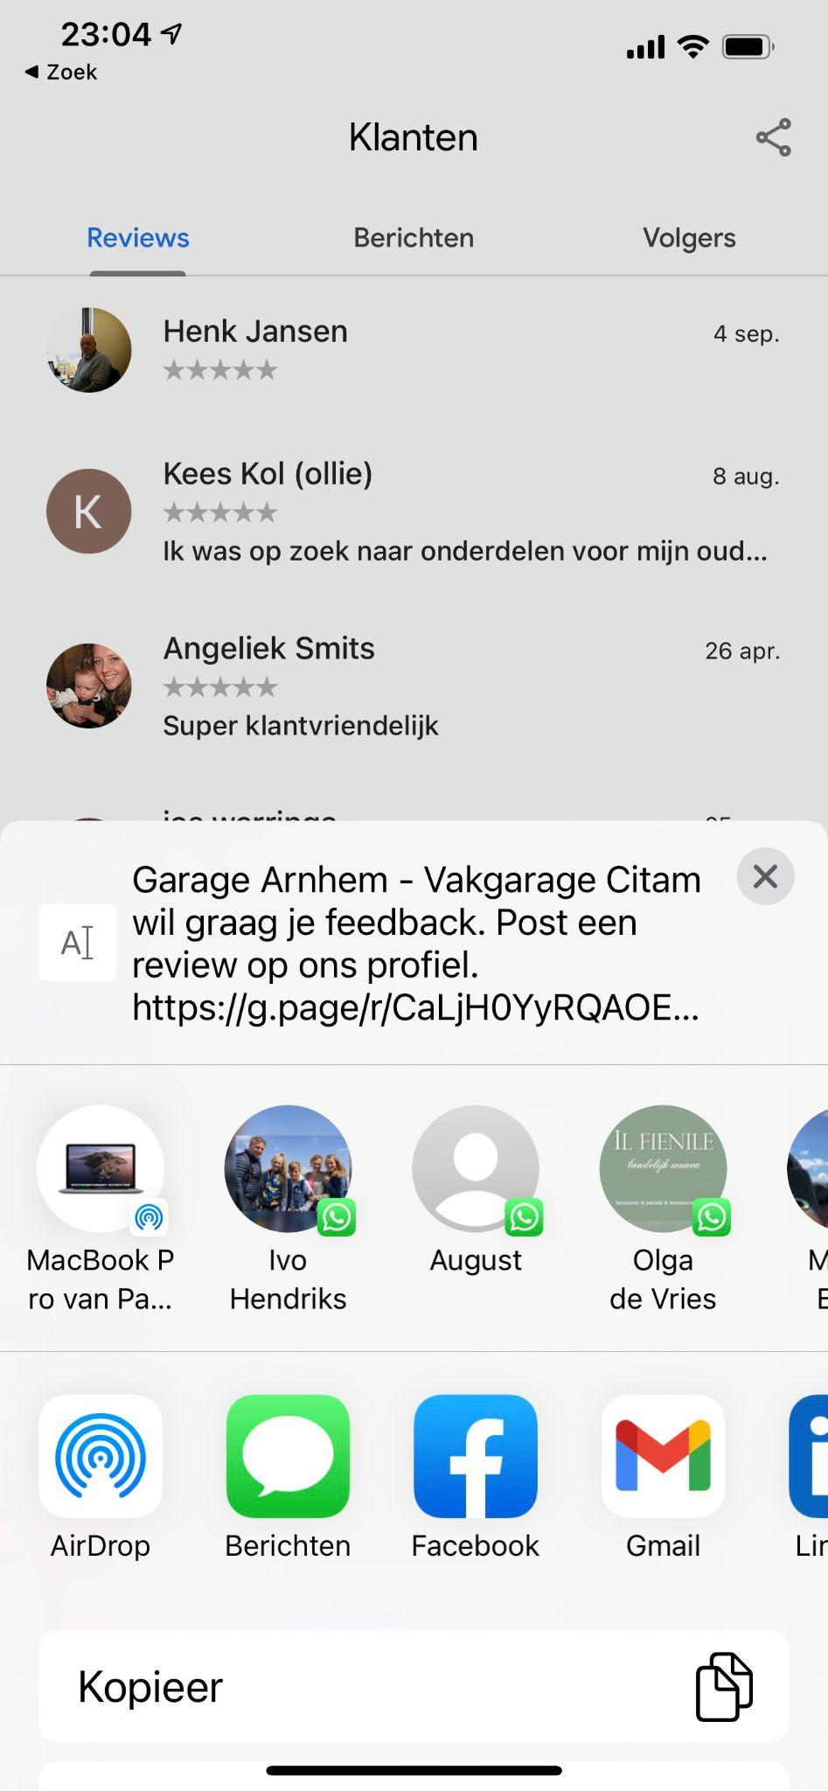
How to get more reviews?
It is not only about 5 star reviews!
What they write is just that important!

Slide 17
Prominence
You need at least 20 reviews to get noticed, and then more is better!

Slide 18
Relevance
What does Google and especially GMB needs?
INFORMATION

Slide 19
Relevance
It all starts with your categories!
You have 10 categories!

Slide 20
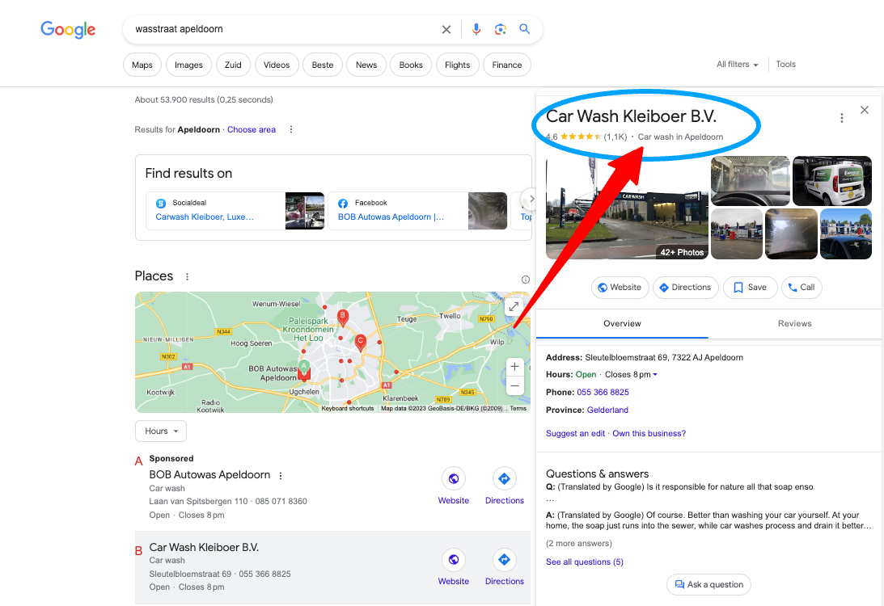

Slide 21
Relevance
Car wash - Self Service Car wash - Auto Parts Store - Bike Wash - Boat cleaning - Carpet Cleaning

Slide 22
The Next phase
Services
FAQ
Description
Website UTM (Unified Threat Management)
Opening hours
Add photos

Slide 23
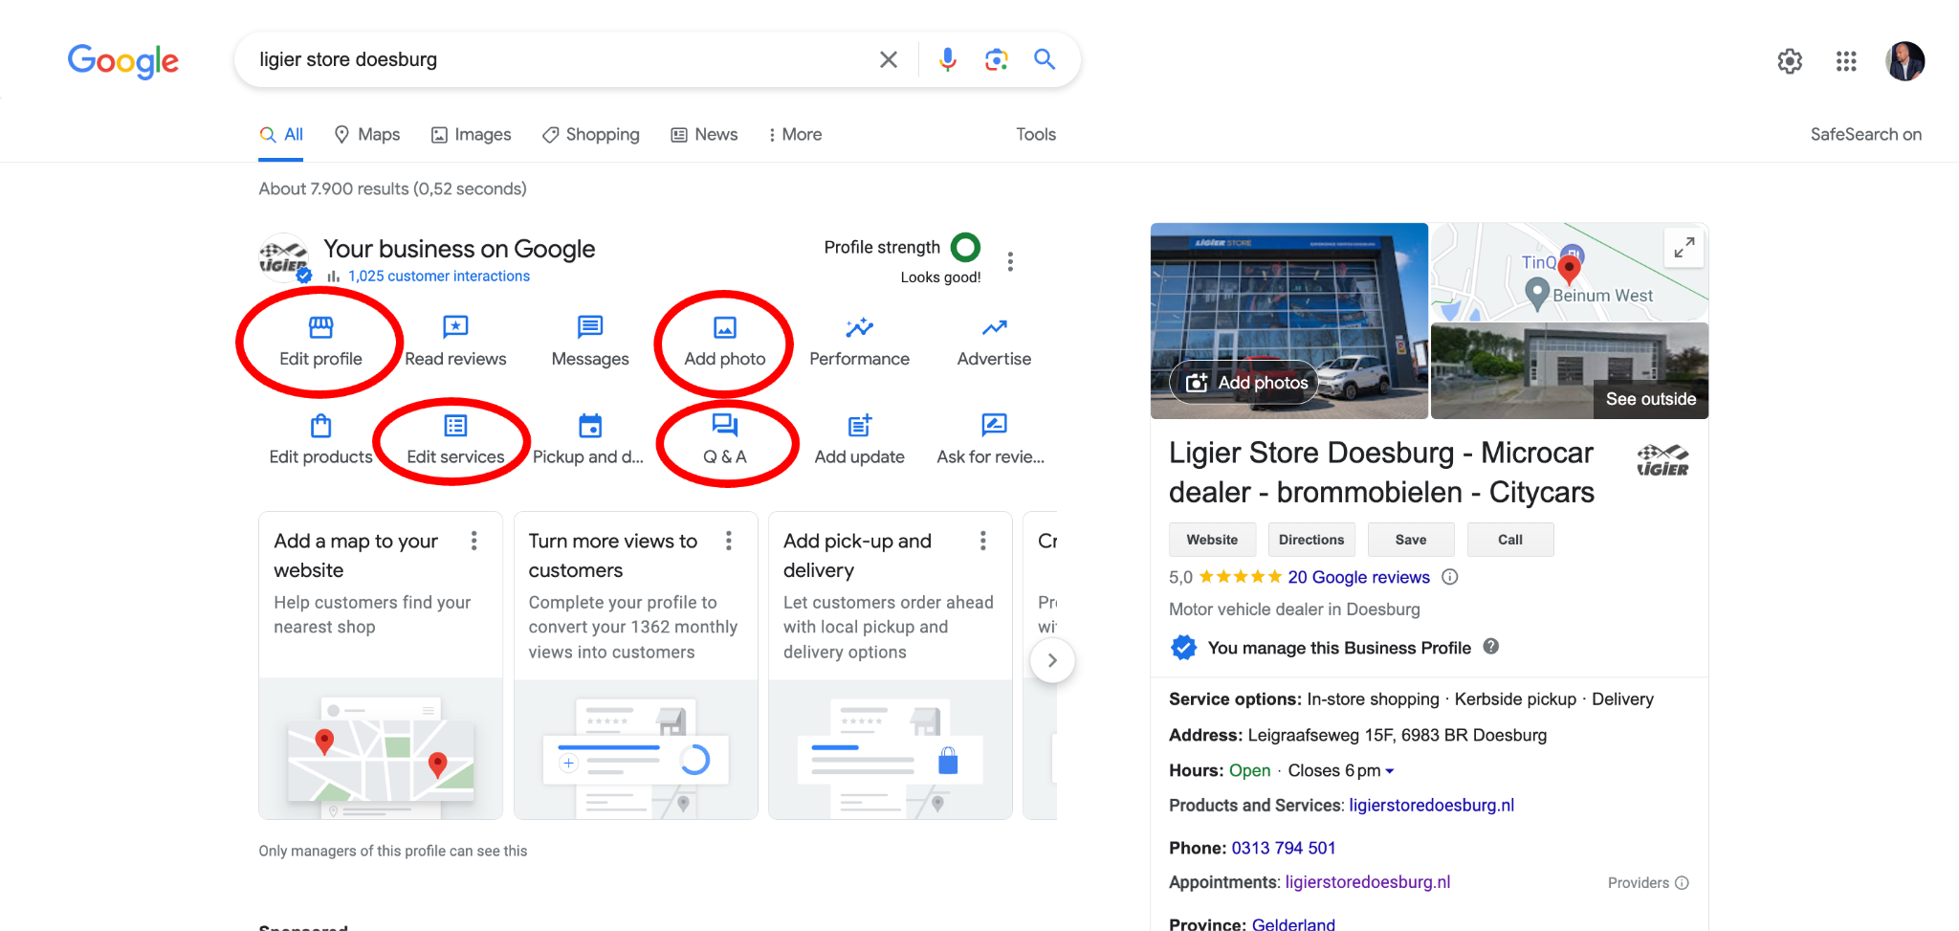
Services

Slide 24
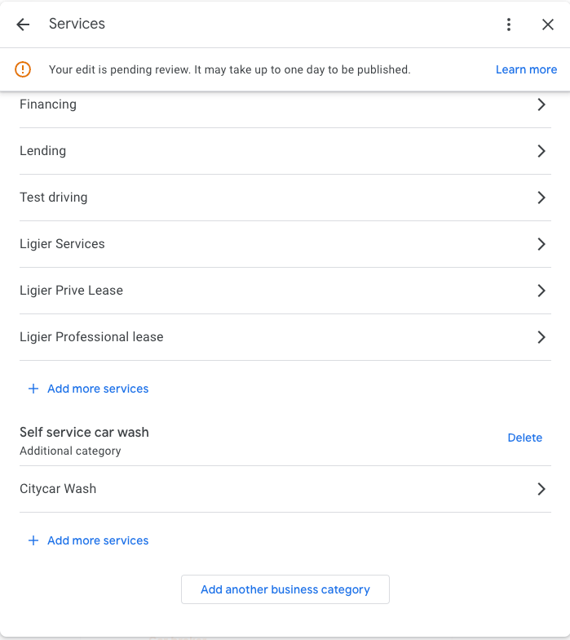
The Next phase

Slide 25
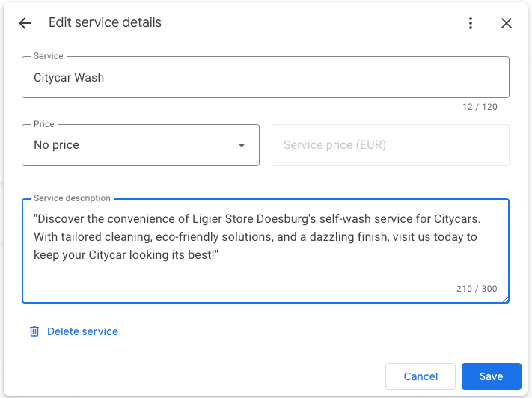
The Next phase

Slide 26
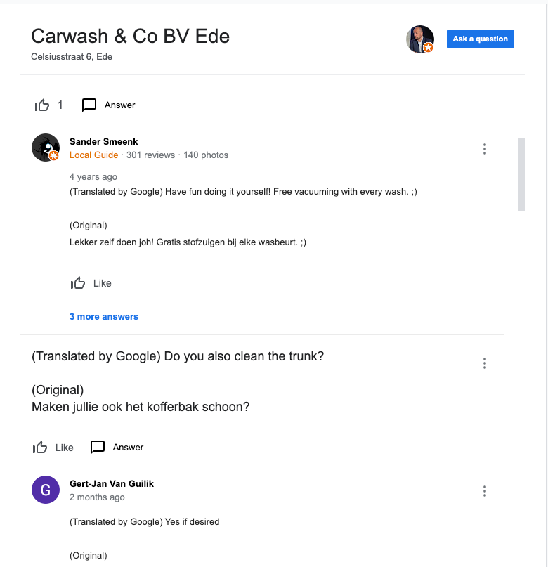
FAQ
Good Questions, horrible answers

Slide 27
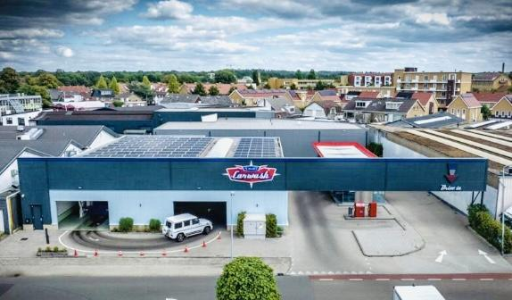
Add photos

Slide 28
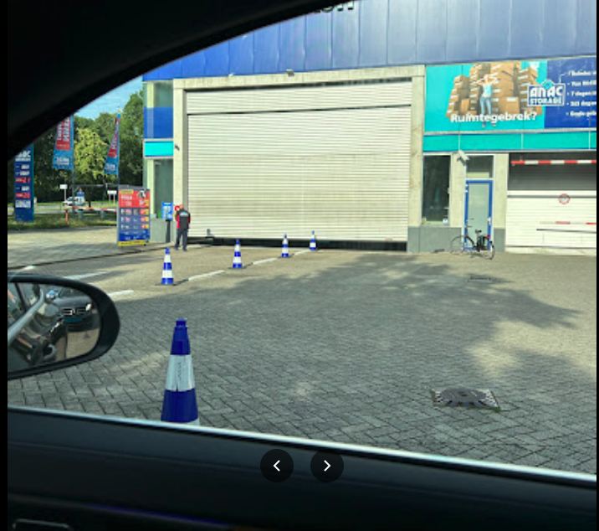
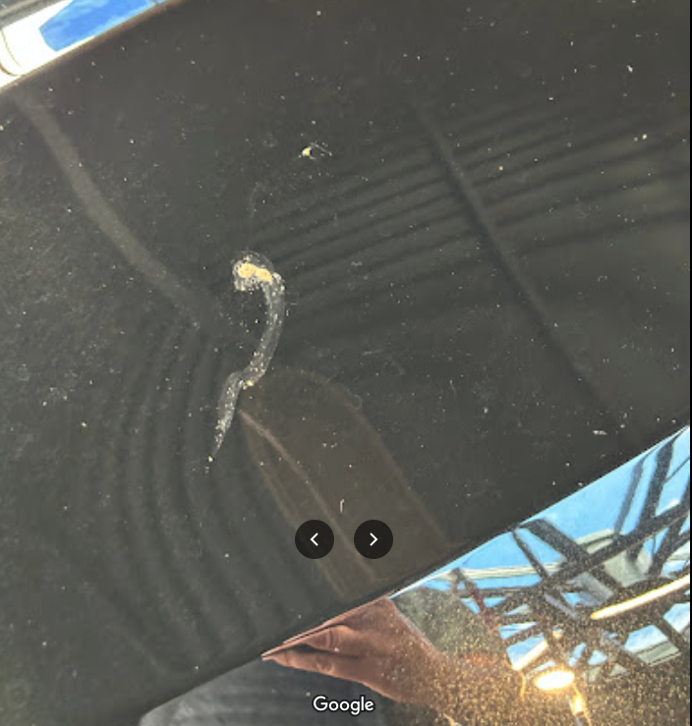
Add photos

Slide 29
Add photos
At least 100 photos of owner!!

Slide 30
It is just work!
No it is not easy, it changes all the time! But if you give it water, it will flourish!

Slide 31
Thank you!
Linkedin.com/pauldevries1972

