Slide 1
The future of washing cars: can we keep using water?
Stijn Schouterden (BleuBlue), Klaus Steiner (INOWA)

Slide 2
BleuBlue: waterrecyling for carwash Belgium
tunnels, rollovers, truckwash, selfwash

Slide 3
Technologies: Aeration – Filtration fix bed biology Moving Bed Bio Reactor Membrane Bio Reactor

Slide 4
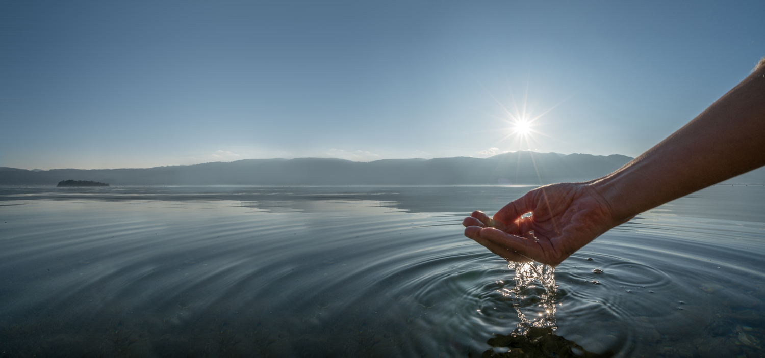
FULLY BIOLOGICAL WASHING WATER TREATMENT
BECAUSE WATER
IS OUR FUTURE

Slide 5
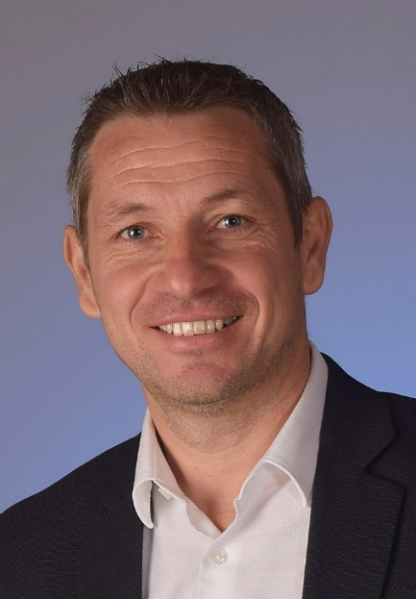
PERSON
Ing. Klaus Steiner MSc
47 Years
Since 1999 in Waste Water Business. Starting in sales
Since 2019 Sales Manager and
business Manager

Slide 6
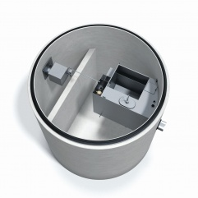
PRODUCTS
Sludge traps
Maintenance free oil separators
Oval basin systems
Storage basins
Products

Slide 7
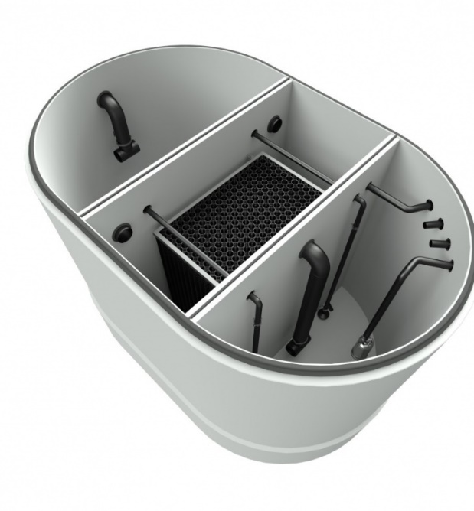
PRODUCTS
filtration units
fully biological washing water
treatment
fully biological washing water
treatment also for self service
car wash
Products

Slide 8
PROCEDURES

Slide 9
PERSON

Slide 10
PERSON

Slide 11
PERSON

